Slide 1
Microservice Placement and Migration for Multi-Access Edge Computing: A Proactive Approach
By
Sreyashi Mukherjee

Slide 2
Abstract
Mobile Edge Computing(MEC)has emerged as a new paradigm in recent times. Vendors deploy services on MEC servers to improve performance and mitigate network latencies. Service placements policy determines which services are deployed on which MEC servers, moreover microservice placement is a challenging task. Existing microservice placement is based on on-demand startegies. This paper proposes a Reinforcement Learning based proactive mechanism for microservice placement and migration.

Slide 3
Introduction
User service invocations are routed to, and served from nearby MEC servers on their route with improved latency and turnaround times. Here the main challenge is to determine a service placement policy that determines which services are deployed on which MEC servers.
The service-server-user mapping needs to be judiciously planned.
Previously a reactive placement strategy was used which was an on-demand approach.

Slide 4
Once the user moved out of the coverage area of the edge server the service container was de-comissioned.
When user moves to a coverage area of a new edge server and registers same service request, the service container used earlier is instantiated and state migration of user data needs to be carried out.
In microservice architecture, application is split into a set of small independent interacting microservices which has inter dependencies.
Microservice based applications are represented as DAG’s.

Slide 5
Our proposal uses RL exploration-exploitation setup, that incrementally learns the most promising strategy for provisioning the constituent microservices.
Pre-fetch and pre-provision microservices provides better latency requirements in MEC which outperforms traditional reactive placement strategies.

Slide 6
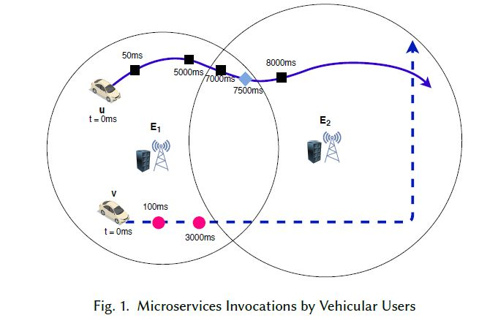
Motivation Example

Slide 7
When a user invokes a microservice, the container corresponding to the microservice has to be deployed on an edge server if the container is not already present. On the other hand, if the container corresponding to the microservice already exists on the edge server, a new task is spawned out of the existing container. On the other hand, a state-aware migration has to be performed when an user actively using a microservice moves out of the service area of the server where it is hosted.

Slide 8
Parameter assumption
Initialize a container – 25ms
create a new task in an already existing container – 10ms
to perform a state-aware migration of a container from one server to another- 30ms

Slide 9
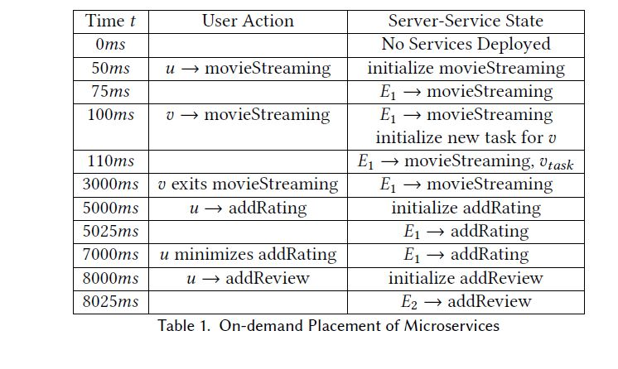
On-demand Placement of Microservices

Slide 10
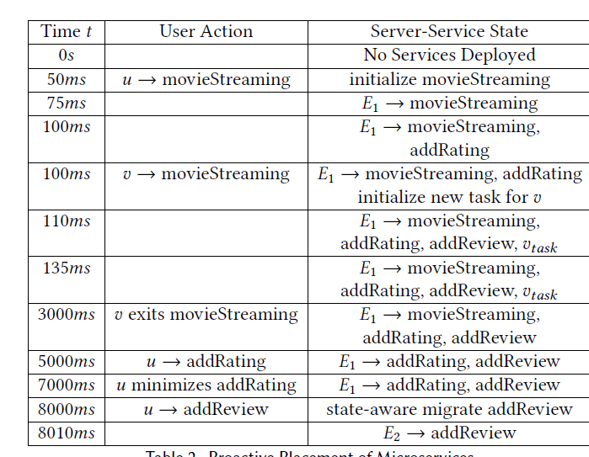
Proactive placement of microservices

Slide 11
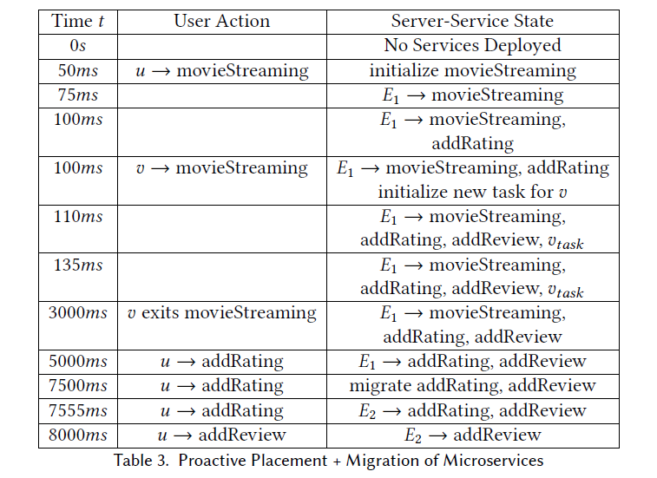
Proactive prefetching and migration of microservices

Slide 12
The challenge is in determining for a given microservice, how many successor microservices to deploy proactively, and the target edge servers to deploy them as the user moves and accesses these enroute.

Slide 13
Formal Model
Problem Definition-
set of edge servers denoted as 𝐸 = {𝐸₁, 𝐸₂, ..., 𝐸_{𝑝} }, where each 𝐸_{𝑖} is associated with a service radius 𝑟_{𝑖} .
set of users 𝑈 = {𝑢₁,𝑢₂, . . .𝑢_{𝑞} }
set of applications 𝐴 = {𝐴₁,𝐴₂, . . .𝐴_{𝑟} }.
An application 𝑎 ∈ 𝐴 comprises a linear workflow of microservices 𝑆 = {𝑠₁, 𝑠₂, ..., 𝑠_{𝑛}} with special exit nodes.

Slide 14
For a user u, 𝑢(𝑡 ) denote the user’s current location at time slot 𝑡 .
The set of active microservices associated with 𝑢(𝑡 ) as ℎ(𝑡 ) and the corresponding location as 𝑙 (𝑡 ). The set ℎ(𝑡 ) can only be co-located at a single 𝑙 (𝑡 ).
At each time-slot, it observes 𝑢(𝑡 ), ℎ(𝑡 ) and 𝑙 (𝑡 ), and decides on placing/migrating the relevant services ℎ(𝑡 + 1), so that the user experiences the best latency values.

Slide 15
Choice of our policy agent
Proactively Placing Microservices - At any location 𝑢(𝑡 ), when 𝑢 invokes a microservice 𝑠𝑖 ∈ 𝑆 whose successor microservices are {𝑠_{𝑖}+1, 𝑠_{𝑖}+2, ..., 𝑠_{𝑛}}, the agent selects the nearest server 𝐸_{𝑖} ∈ 𝐸 to deploy 𝑠_{𝑖} along with 𝑗 successor microservices, i.e., {𝑠_{𝑖}+1, 𝑠_{𝑖}+2, ..., 𝑠_{𝑖}+𝑗 }, where 0 ≤ 𝑗 ≤ 𝑛 −𝑖, and updates ℎ(𝑡 + 1) = ℎ(𝑡 ) ∪ 𝑠_{𝑖} ∪ 𝑠_{𝑖}+1 ∪ 𝑠_{𝑖}+2 ∪ ... ∪ 𝑠_{𝑖}+𝑗 .
Microservice Migration - When a user 𝑢 moves away from the service zone of the server on which ℎ(𝑡 ) was deployed, the agent performs a state-aware migration to re-deploy the microservice currently in use to the edge server nearest to the user’s new location. Other microservices which are not currently in use are re-initialized. In this case, ℎ(𝑡 ) = ℎ(𝑡 +1), but 𝑙 (𝑡 ) ≠ 𝑙 (𝑡 +1). Performing such a state-aware migration for active services incurs a cost𝑚(𝑟 ), where 𝑚 is a non-decreasing function of 𝑟 whereas re-initialization incurs cost 𝑐 (𝑟 ).

Slide 16
State Representation of MDP
We define our policy agent for proactive placement and migration as an MDP, as follows-
A MDP is a tuple (S, T, P, A, Ra) where :
S is a finite set of states
T is the transition function from s ∈ S to a subset {𝑠₁, 𝑠₂, . . . 𝑠_{𝑛}} ∈ S denoting all successor states of s.
• P : S × S→ Í [0, 1] denotes the probability distribution on transitions such that for all states 𝑠 : 𝑠′∈𝑆 𝑃 (𝑠, 𝑠 ′) = 1
• A is the set of actions, i.e, from a state s, upon an action a ∈ A(s), the successor state s′ is determined by T(s).
• 𝑅𝑎 (𝑠, 𝑠 ′) is the immediate reward (or expected immediate reward) received after transitioning from state s to state s′ , due to action a ∈ A.

Slide 17
Transition representation of MDP
Intra-block transitions- When user moves from one location to another or when there is transfer of control from one microservice to its subsequent microservice.
Inter-block transitions- Transitions between blocks represent the possibility of proactively prefetching variable number of microservices.

Slide 18
Migration of microservices
Migration occurs when a user moves from one zone to another. When multiple servers are present in the new service zone then the nearest server is selected. We assume that the MEC servers are distributed such that each area is in the coverage of at least one MEC server, hence a target server always exists.

Slide 19
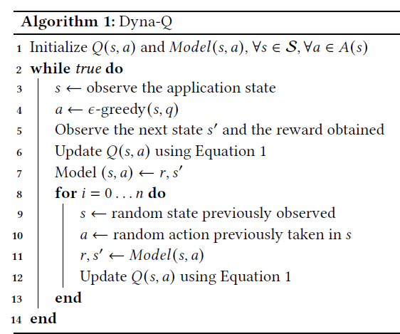
Reinforcement learning solution

Slide 20
Equations
At the end of each time slot 𝑖, 𝑄(𝑠, 𝑎) is updated as follows –
𝑄(𝑠, 𝑎) ←𝑄(𝑠, 𝑎) + 𝛼[𝑟 + 𝛾 argmax_{𝑎}𝑄(𝑠 ′, 𝑎) − 𝑄(𝑠, 𝑎)] where 𝛼 is the learning rate assigned to the agent. The equation updates the Q-value of state𝑠 by determining the action corresponding to the highest Q-value among all successor states (argmax_{𝑎}𝑄(𝑠 ′, 𝑎)), which is discounted by 𝛾 and updated according to the reward 𝑟 observed from the environment.
The reward function denoted by 𝑅 is a weighted combination of resources consumed by prefetched microservices actually utilized and prefetched microservices not invoked by the user.
𝑅 =Σ_{𝜇 ∈𝜇𝑢𝑠𝑒𝑑}[𝜇 ∗ 𝑐 (𝜇_{𝑟𝑒𝑠𝑜𝑢𝑟𝑐𝑒𝑠} )] − Σ_{𝜇 ∈𝜇n𝑢𝑠𝑒𝑑}[𝜇 ∗ 𝑐 (𝜇_{𝑟𝑒𝑠𝑜𝑢𝑟𝑐𝑒𝑠} )]
𝜇_{𝑢𝑠𝑒𝑑} and 𝜇_{𝑢𝑛𝑢𝑠𝑒𝑑} are sets of indicator variables representing the set of prefetched services have been invoked and not invoked respectively while 𝑐 (𝜇_{𝑟𝑒𝑠𝑜𝑢𝑟𝑐𝑒𝑠} ) represents the resource costs of microservice 𝜇 according to cost function 𝑐 (𝑟).

Slide 21
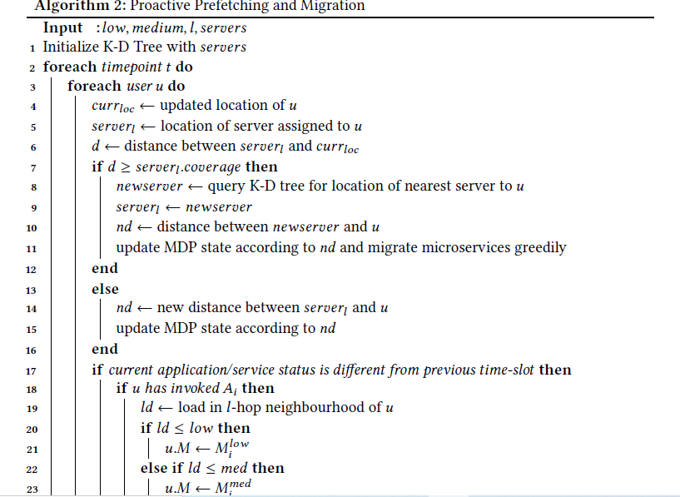

Slide 22
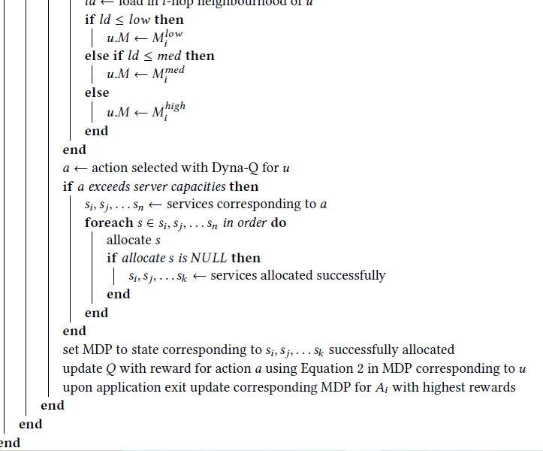
continuation

Slide 23
Algorithm explanation
Initializes a K-D Tree with the location of the MEC server
Update the locations of the users in the current slot.
MDP is updated to the value of the normalized distance from the currently assigned server and the updated location of the user.
It Checks the service usage status of the users in the current time slot and calls the Dyna-Q algorithm.
Depending on the action selected by the Dyna-Q algorithm and the subsequent greedy placement, the state of the MDP and the Q-values are updated with the generated rewards.
The algorithm greedily selects the set of microservices when prefetched microservices can not be accommodated on the server.
When server capacities exhaust it proceeds to set the MDP state to reflect the microservices which have been successfully allocated greedily.
Once a user exits the application, the MDP is updated accordingly.

Slide 24
Experimental setup
MEC Server Locations and User Trajectories-We consider a discrete time slotted system in which the locations of users in the network may change from one time slot to another. The MEC users and server locations are modeled from real-world mobility traces of taxis in San Francisco that are publicly available. The coverage area of each MEC server is randomly generated.

Slide 25
Service Invocations - We use microservices from the ‘Media Microservices’ application of the ‘DeathStarBench’ benchmark suite. This suite presents microservice based applications in domains such as social media, e-commerce, banking, movies and drone swarms and has been used in a range of studies such as hardware and networking implications of microservices and performance debugging of cloud microservices.

Slide 26
results
Our approach considers proactively deploying any of the application components and also considers coverage area zones of MEC servers.
We vary the total number of users from 50 to 300 at an interval of 50. For each scenario, we additionally vary the learning rate 𝛼 as {0.1, 0.2, 0.3, 0.4}.
With a higher learning rate, a wider variation in reward accumulation is observed in general, since a higher learning rate corresponds to a greater weightage in Q-value updation in each iteration.

Slide 27
Some other observations
As the value of 𝑘 is increased, the size of the MDP increases.
there is no definite increase/decrease pattern with respect to varying 𝑛 and the number of users as observed previously when we studied the impact of 𝑛 on latencies

Slide 28
Related work
Computation Offloading
Service Placement
Service Migration
Service Allocation/Routing
Microservice Placement and Migration
Service Placement with Prediction

Slide 29
conclusion
We propose a learning based mechanism to proactively deploy microservices on edge servers considering microservice graph application structures by considering a linear workflow of microservice. Experimental results on real datasets demonstrate the amount of latency improvements that the scheme leads to.

Slide 30
Future work
Future work can be based upon –
Investigating encoding of capacity constraints in our MDP formulation
Cost functions which consider runtime usage of resources.
Along with this aggressive prefetching can also be addressed.

